Slide 1


Slide 2
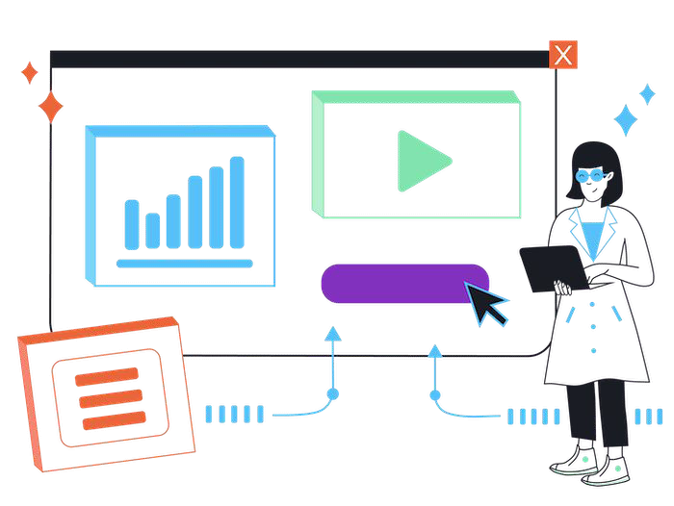

How to make a website
Websites are a mixture of many technologies working together to provide our online experiences.
However the basic building blocks are relatively straightforward. To get started building a website we simply need two things on our computer:
Web Browser
Text Editor
With these tools you can create HTML, CSS and JS ﬁles locally and run the website locally without any additional software.
If you want to have more complex behaviour using databases and backend components then you will need more tools, but not many!

Slide 3

Editors
One of the core tools for any programming is the editor. There are a variety of tools for developers to pick from when it comes to their editor, generally we split these into the below categories:
Basic Text Editor
Advanced Text Editor
Integrated Development Environment (IDE)
Visual Editor
In our labs, and most likely in other modules, we will be using Visual Studio Code.
Visual Studio Code is a mix between an advanced text editor and an IDE - this gives us a speed close to an advanced text editor, but with many key features of an IDE.

Slide 4
HTML stands for Hyper Text Markup Language

Slide 5
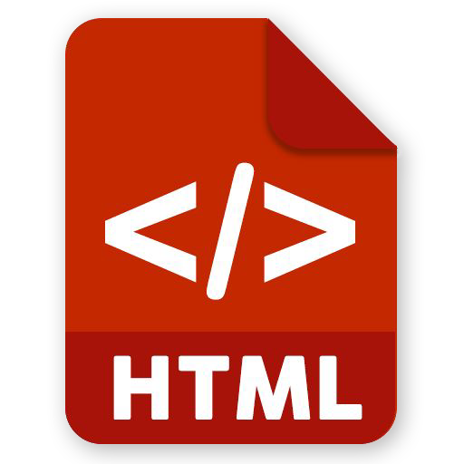
What is HTML
HTML, or HyperText Markup Language, is the standard language for creating web pages.
It describes the structure of a web page using a series of elements which tell the browser how to display the page.
We use HTML to structure our code and content, these elements (or tags) often have attributes also to help describe them in more detail.
HTML can contain various types of media(video, audio, images) and load in other resources such as fonts.
HTML alone generally provides only the structure of the page, we combine this with CSS to apply our own styling to this structure.

Slide 6
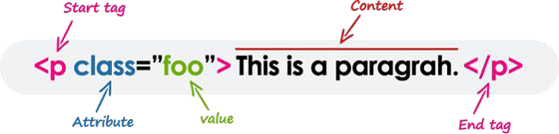
HTML Tags
There are approx. 142 deﬁned HTML tags for use when creating your websites. Some 27 of these are legacy tags no longer used or obsolete leaving 115 in common use.
Some of the most commonly used tags, outside of “HTML”, “head” (including ones inside) and “body”, are:
Heading Tags (H1-H6)
<h1>Header</h1>
Paragraph
<p>Paragraph</p>
Anchor
<a>Link</a>
Image
<img />
Division
<div />
In today’s lab we will have a very basic introduction to tags however I strongly encourage you to experiment with other tags in the labs.

Slide 7
keywords surrounded by angle brackets
<html>

Slide 8
Tags normally come in pairs
<p>…</p>

Slide 9
An HTML element is everything from the start tag to the end tag:
<p>Paragraph.</p>
<br />

Slide 10
Attributes provide additional information about HTML elements.
<img src=“image.png” />

Slide 11

elements should be in lower case

Slide 12
<html>
<body>
<h1>My First Heading</h1>
<p>My first paragraph.</p>
</body>
</html>
browser does not display the HTML tags, but uses the tags to interpret the content of the page

Slide 13


Slide 14
“HTML5 was the proposed next standard for HTML 4.01, XHTML 1.0 and DOM Level 2
HTML. It aims to reduce the need for
proprietary plug-in-based rich internet application (RIA) technologies such as Adobe Flash, Microsoft Silverlight, Apache Pivot, and Sun JavaFX.”
http://en.wikipedia.org/wiki/HTML5

Slide 15
Some of the new features in HTML 5 were functions for embedding audio, video, graphics, client-side data storage, and interactive documents.
https://www.w3schools.com/html/html_media.asp

Slide 16
DOCTYPE
<!DOCTYPE html>
http://www.w3schools.com/tags/tag_doctype.asp

Slide 17
Comments
<!-- a comment -->

Slide 18
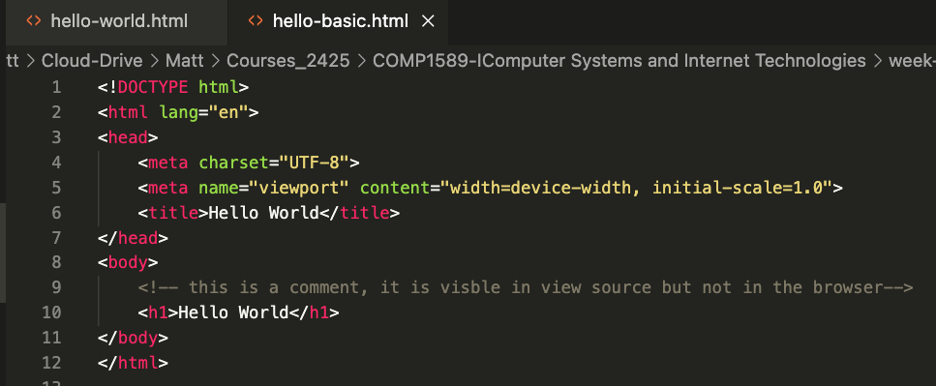
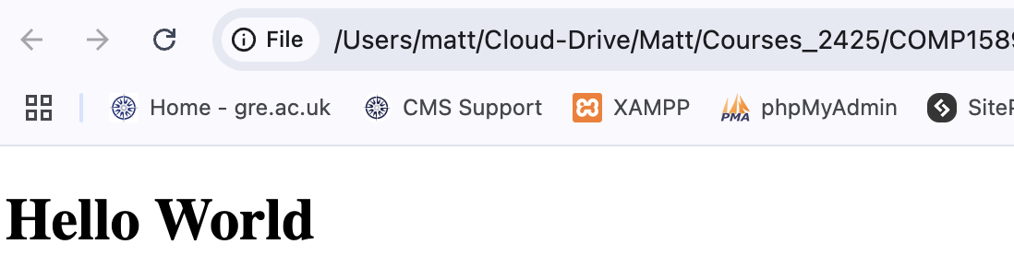


Slide 19
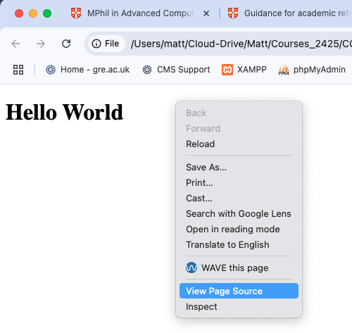
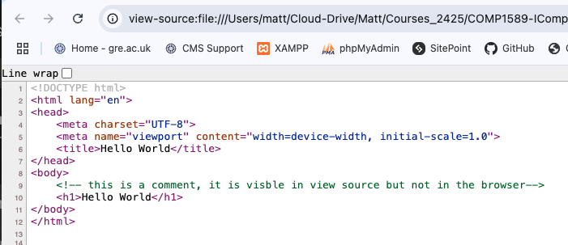
Right click on your web page and select “View Page Source” to view the HTML of the page

Slide 20
Html Demonstration
Head/Body (head, body, title)
Headings (h1, h2, etc.)
Paragraphs (p)
Links (a)
Images (img)
Empty elements (br, hr)
Simple Formatting (strong, em, code, small)
Lists (ul,ol,li)
Sections (div)

Slide 21

Navigating the web
When we navigate the web there are lots of terms that are thrown around:
Click the link
Go to the URL
Two terms that are less used, but are important are
Anchors and Hyperlinks.
A link is simply the shorthand for a hyperlink, simply put it links one page to another - usually by URL.
An anchor is the HTML element that lets us deﬁne a hyperlink on a page. Within this we use the “href” attribute to indicate the links destination.
As well as linking to other pages anchors can also link to sections within the same page…
This allows users to be taken to speciﬁc parts of a page automatically with the browser scrolling them there.

Slide 22
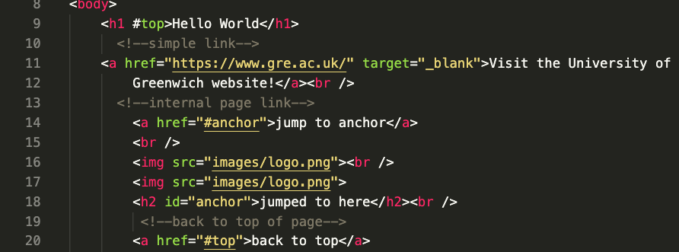
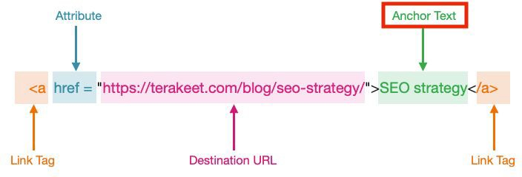
week1/anchors.html

Slide 23
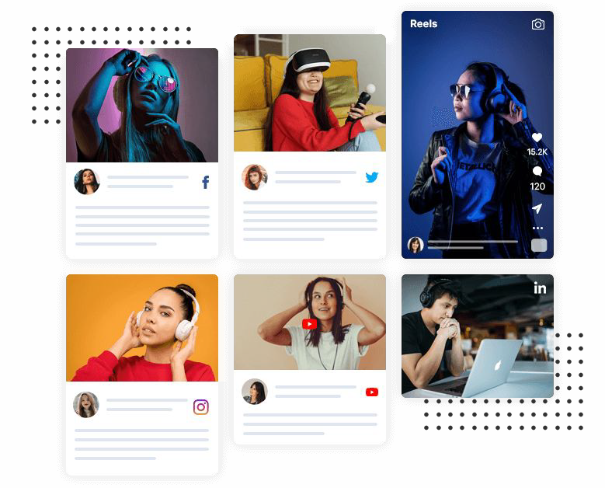
Multimedia
The majority of the internet now is full of media elements, this is due to the speed of internet and advancements in browser technology.
In previous years we would have to use technology such as Java or Flash to present most media elements (except images). In modern browsers we can natively display rich media elements such as videos and audio ﬁles.
However we still have some limits around this technology. The two main limitations to be aware of are:
Auto-playing Media
Media Formats

Slide 24
HTML 5 also contains new elements like <nav>,
<header>, <footer>, and <figure>.
These are Semantic tags

Slide 25
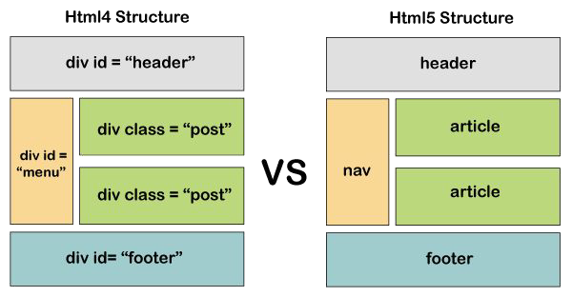
HTML Versions
The ﬁrst version of HTML was created in 1991, since then there have been improvements and iterations in it.
The last standard version is HTML5.2 that was
set-out in 2017, however HTML is now known as a Living Standard - this means that the standard simply progresses over time with no formal versioning.
For modern web development the main changes came in around 2014 when HTML5 became the standard and moved us away from XHTML and HTML4.
HTML5 introduced a variety of new elements such as the video and audio tag but also new semantic tags. These tags give more deﬁnition to our page structure that help with accessibility and SEO.

Slide 26
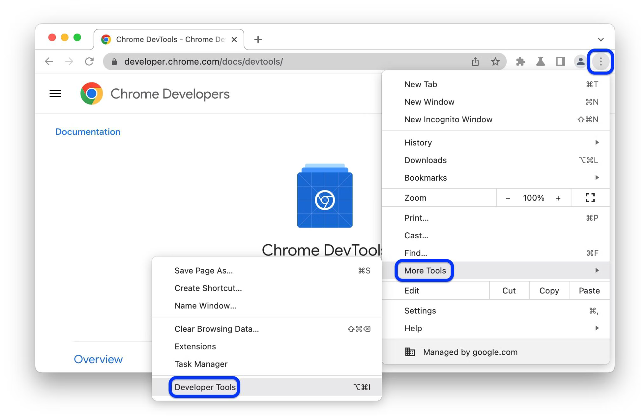
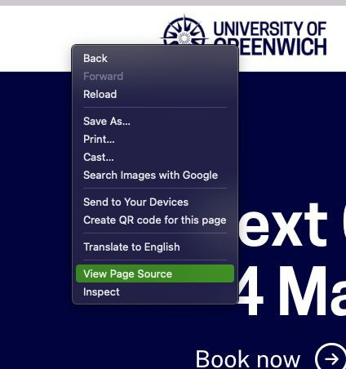
Inspect & View Source
The ﬁnal item I want to discuss is how to inspect and view source of websites, this section will be speciﬁcally targeted to Chrome however most browsers will have this functionality.
View Source
This is the simplest way to view a website's HTML code. Simply right click on the page, and select “View Page Source”.
This will show you the HTML code as it is sent to the browser, this is before any other javascript code has manipulated it.
Inspect
The drawback to the above is that it’s non-interactive, it’s hard to read and doesn’t necessarily represent the code you’re seeing/interacting with.
If we right click and select inspect (or enable Developer Tools) we will see a screen load that shows us the HTML code as the browser is rendering it. This tool lets us look in much more detail and allows us to manipulate the code live.

Slide 27
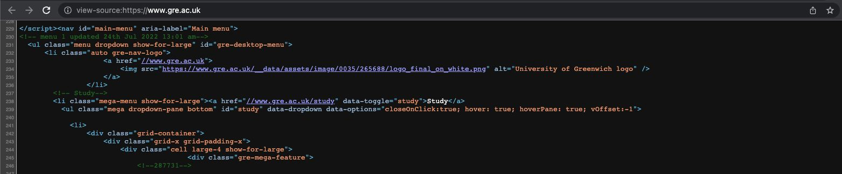
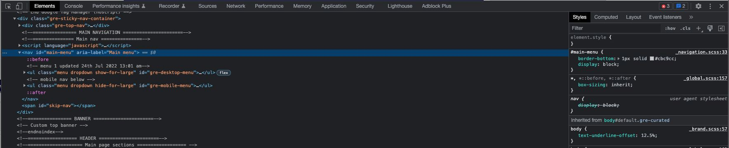

Slide 28


Photo by Polina Zimmerman: Pexels
Lab
This week we will be getting everyone familiar with their development environment.
This will be utilising Visual Studio Code to create a simple HTML ﬁle and then becoming familiar with viewing this ﬁle in Chrome.
Finally you will be interacting with the webpage using Chrome Dev Tools.
Your lab tasks are available on Moodle.

